Slide 1



Significantly Improving Zero-Shot X-ray Pathology Classification via Fine-tuning Pre-trained Image-Text Encoders
Jongseong Jang, Daeun Kyung, Seung Hwan Kim, Honglak Lee, Kyunghoon Bae, Edward Choi
Jeeyoung Kim
University of Ulsan College of Medicine,
Asan Medical Center
77imjee@gmail.com
2023.02.22 Wed

Slide 2
Introduction
In the medical imaging domain, qualified experts are required to create labeled samples.
Recent studies tackled this problem with some success by taking advantage of the powerful pre-trained models trained on large-scale general domain data
CLIP
self-supervisingly trained via contrastive learning on approximately 400M image-text pairs
demonstrated impressive zero-shot classifications that outperformed in lots of datasets
CheXzero
used CLIP’s generalization capability by fine-tuning it with over than 200,000 pairs of CXR and reports
perform zero-shot classification and successfully matching the performance of board-certificated radiologists
it is possible to perform pathology classification even without having an expert-annotated training set
Notes:
by combining the power of a heavily pre-trained model with a moderate amount of domain-specific image-text pairs, it is possible to perform pathology classification even without having an expert-annotated training set

Slide 3
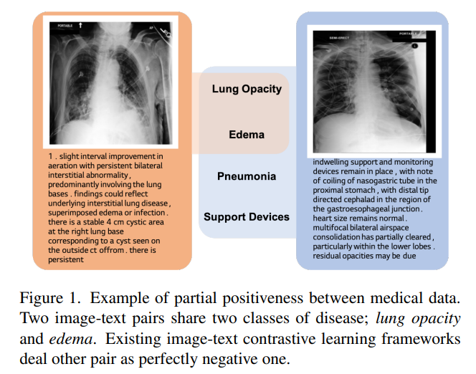
Introduction
Previous zero-shot approach fails to properly address the multi-labeled nature of medical image-report pairs.
Their report must at least share the semantics of Lung Opacity and Edema – partial positive
CheXzero : uses the vanilla contrastive learning, which regards partial positive pairs as completely negative pairs
MedCLIP : another zero-shot pathology classification study, partially addresses this issue but requires expert labels to do so

Slide 4
Contribution
We propose a new fine-tuning strategy for zero-shot pathology classification from unannotated X-ray images.
Using four different CXR datasets and three different pre-trained models, we show that the proposed method consistently improve zero-shot pathology classification performance that average AUROC increase 5.77%
Especially for the CheXpert dataset, fine-tuning CLIP with our method sometimes outperformed board-certified radiologists marginally in detecting five prominent disease with 0.619 vs 0.625 F1 scores and 0.530 vs 0.433 in MCC
Notes:
Our fine-tuning strategy also showed consistent performance improvement for image-text alignment. Ablation studied were simultaneously conducted to verify the effectiveness of the proposed fine-tuning method.

Slide 5
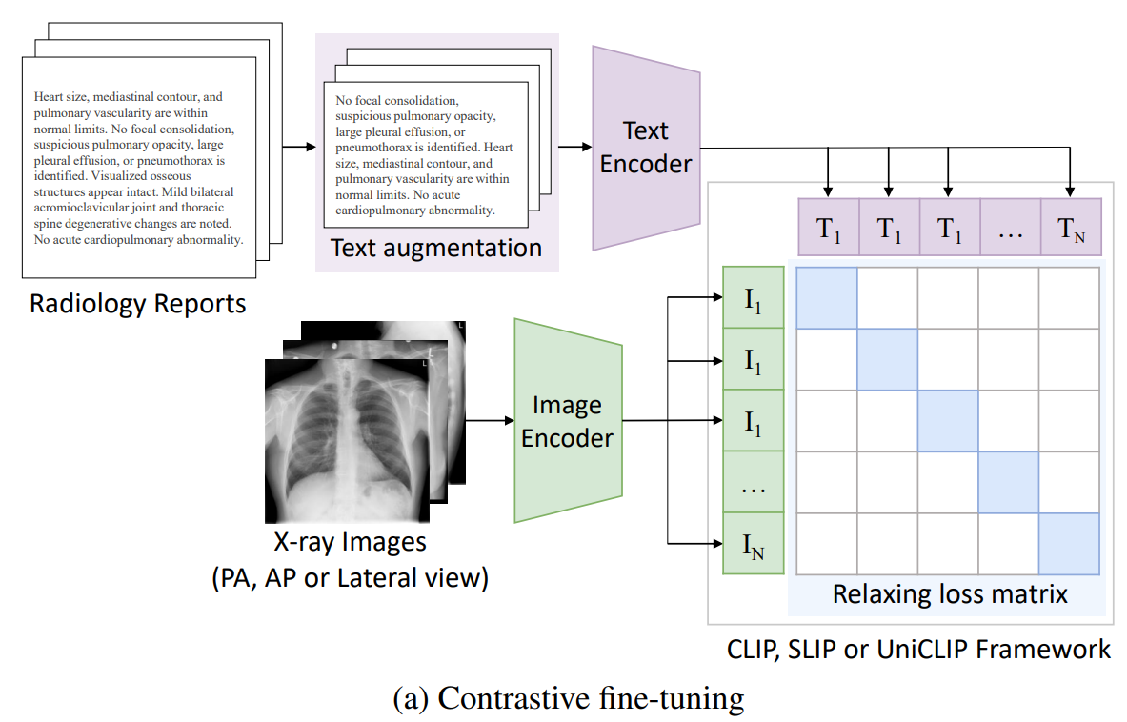
Methods
Random text augmentation
Loss for relaxed image-text agreement

Slide 6
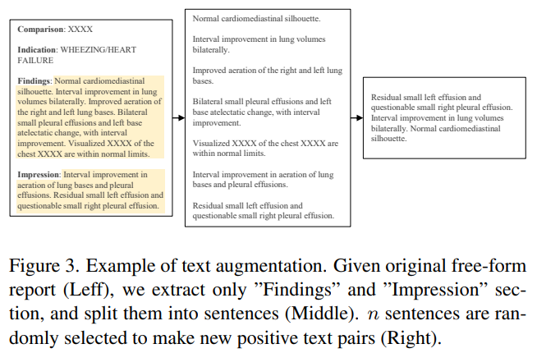
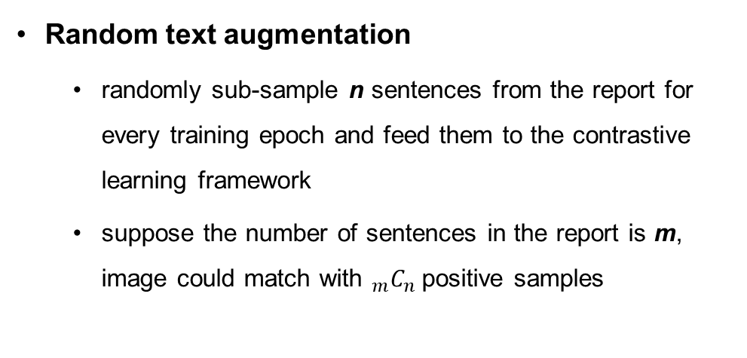
Methods – Random text augmentation
Medical reports
consist of meaningful content for diagnosis, and most of the sentences are short and formal
text augmentation in the token-level can be harmful to keep the correct clinical meaning of reports
Random text augmentation
randomly sub-sample n sentences from the report for every training epoch and feed them to the contrastive learning framework
suppose the number of sentences in the report is m, image could match with ${}_{m}^{ }{C_{n}}$positive samples
Notes:
conventional text augmentation is useless in the medical domain due to being distort the semantics

Slide 7
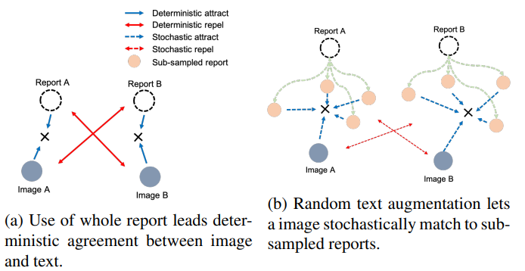
Methods – Random text augmentation
When using the whole report, negative pairs deterministically repel each other even if there is shareable information (a)
When using random text augmentation, an image can stochastically attract various positive texts while the chances to repel the negative text of the same pathology can decreased due to stochastic property (b)

Slide 8
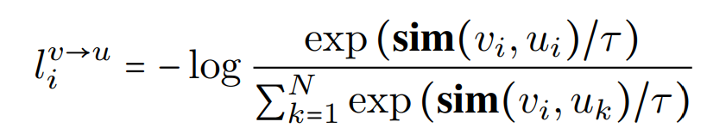
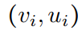
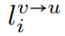
Methods – Loss for relaxed image-text agreement
CLIP (InfoNCE loss)
v, u are normalized vector from image and text encoders
is a positive pair, sim is a function to calculate similarity between vectors
means learnable temperature, N is the mini-batch size
means the InfoNCE loss from image to text

Slide 9
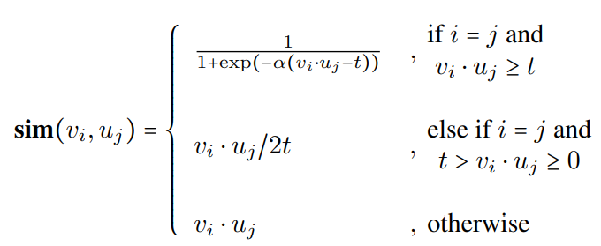
Methods – Loss for relaxed image-text agreement
In the medical domain a report and image for different patients are likely to have shareable information about pathologies
If naively using the InfoNCE of CLIP method, it’s hard to share the information with other pairs
we cannot easily explore the additional positive sample which shares the same semantics without label information
means cosine similarity between vectors
is slope coefficient of Sigmoid function
is threshold from which similarity level we regard a pair as “positive”
For a positive pair, this can make image-text agreement relaxed so that it makes room to agree with other semantics from different samples

Slide 10
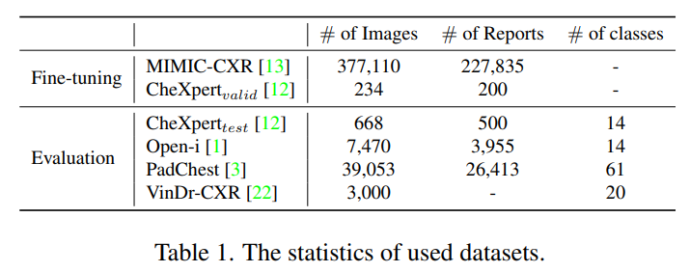
Datasets
MIMIC-CXR for fine-tuning, extract “Findings” or “Impression” section. If the section is not extracted by the rule-base method, we use the last paragraph of those samples
CheXpert : validation set for model selection and the test set for evaluation
PadChest : use test set to evaluate zero-shot classification, image-text alignment
Open-I chest X-ray dataset : use for evaluating image-text similarity and the labelled one for zero-shot classification

Slide 11
Experiments
Baseline
CLIP : multi-modal contrastive learning framework pre-trained on 400M image-text pairs. CLIP uses InfoNCE loss to maximize mutual information of latent vectors from image and text encoders
SLIP : multi-task learning framework that enhances the representation quality by combining image self-supervised learning with CLIP pre-training
UniCLIP : unified framework for visual-language pre-training that improves data efficiency by integrating inter and intra domain pairs’ contrastive loss into a single universal space
text encoder : BERT (base) model
image encoder : ViT-B/16

Slide 12
Experiments – Implementation Details
Augmentation : random crop with large ratio - reduce the intensity of augmentation to avoid information loss (CLIP - resized crop, SLIP, UniCLIP – color jitter, random crop)
random text augmentation – 3 sentences are sampled from each report
relaxation loss threshold is 0.5, and the slope coefficient is fixed at 10
set the image resolution to 224 x 224

Slide 13
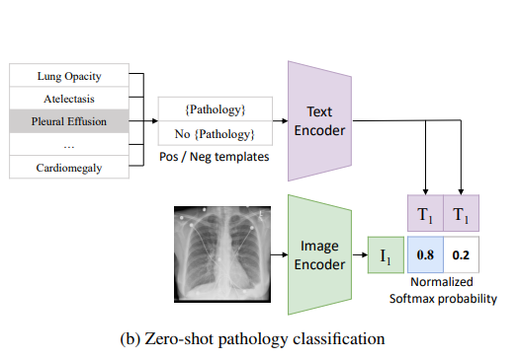
Zero-shot classification
Evaluation
construct positive and negative prompts such as “Atelectasis” and “No Atelectasis” for each pathology
calculate the softmax probability of each pathology through the cosine similarity between the target image embedding and the embedding of the positive/negative prompt

Slide 14
Image-Text alignment
In medical report, each sentence generally contains different label information
We calculate the cosine similarity between image embedding and report embedding for each X-ray-Report pair for report-level evaluation
We also calculate the average similarity between the image and sentence embedding for all sentences in the corresponding report to measure sentence-level alignment

Slide 15
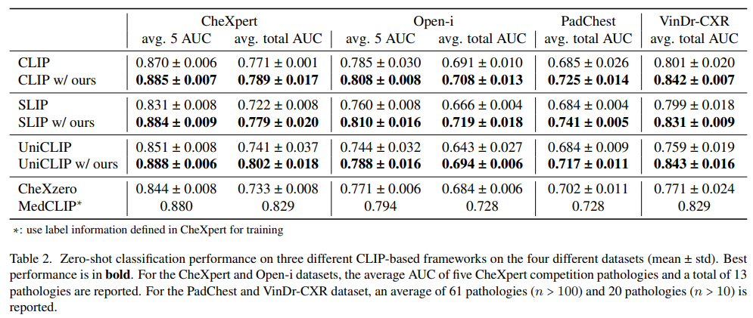
Results – Zero-shot classification

Slide 16
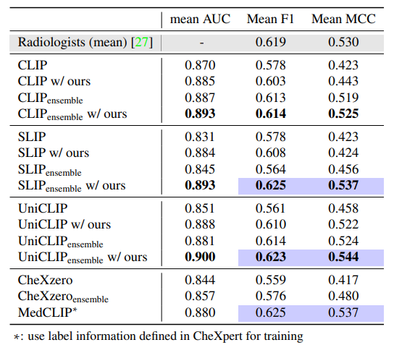
Results – Zero-shot classification
CheXpert

Slide 17
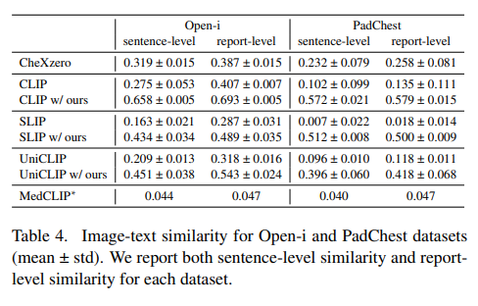
Results – Image-text alignment

Slide 18
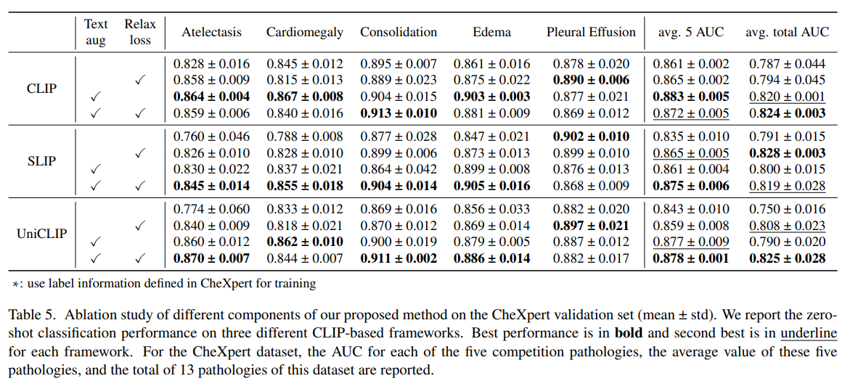
Results – Ablation study

Slide 19
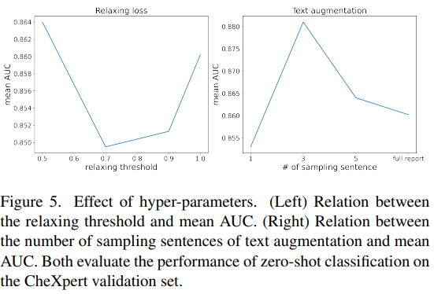
Results – Ablation study

Slide 20
Conclusion
In this paper, we propose a simple yet effective fine-tuning strategy for medical image-text multi-modal learning, which consists of two ways, random sentence sampling, and loss relaxation
Our fine-tuning strategy improves zero-shot pathology classification performance in all three CLIP-based frameworks
In addition, our proposed method significantly outperformed board-certified radiologists without additional label information

Slide 21


Collaborators
Radiology
Joon Beom Seo, SangMin Lee^{A,B}
Dong Hyun, Yang, Hyung Jin Won
Ho Sung Kim, Seung Chai Jung
Ji Eun Park, So Jung Lee
Jeong Hyun Lee, Gilsun Hong
Pathology
Hyunjeong Go, Gyuheon Choi
Gyungyub Gong, Dong Eun Song
Cardiology
Jaekwan Song, Jongmin Song
Young-Hak Kim
Anesthesiology
Sung-Hoon Kim, Eun Ho Lee
Neurology
Dong-Wha Kang, Chongsik Lee
Jaehong Lee, Sangbeom Jun
Misun Kwon, Beomjun Kim, Sun Kwon, Eun-Jae Lee
Surgery
Beom Seok Ko, JongHun Jeong
Songchuk Kim, Tae-Yon Sung
Gastroenterology
Jeongsik Byeon, Kang Mo Kim, Do-hoon Kim
Emergency Medicine
Dong-Woo Seo
Pulmonology and Critical Care Medicine
Yoen-mok Oh, Sei Won Lee, Jin-won Huh

